Slide 1
AI STUDY
2
초급 1

Slide 2
Chapter 1 : Image Classification
CS231n
- Problem of Image Classification
- Nearest Neighbor classifier.
- Parameter Vs Hyperparameter
- Validation set
- Cross-validation

Slide 3
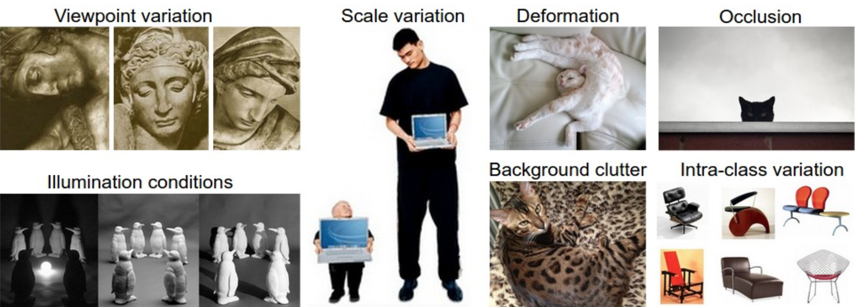
Problem of Image Classification
CS231n Chapter1 : Image Classification

Slide 4
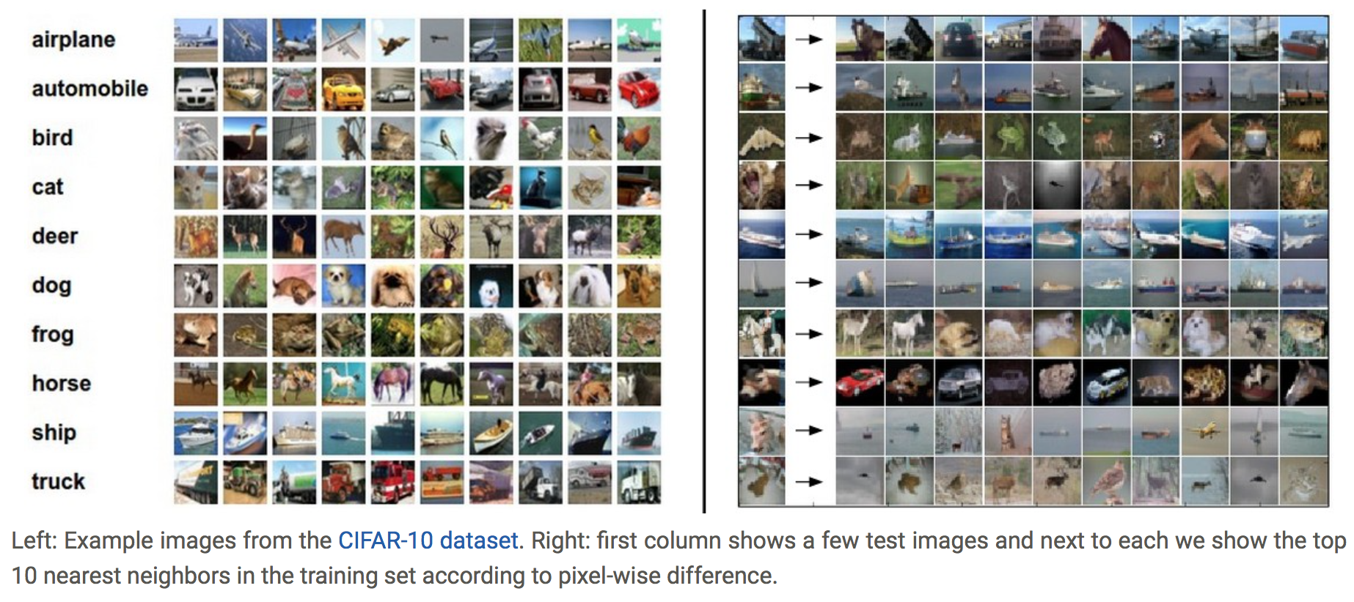
Nearest Neighbor classifier
CS231n Chapter1 : Image Classification

Slide 5
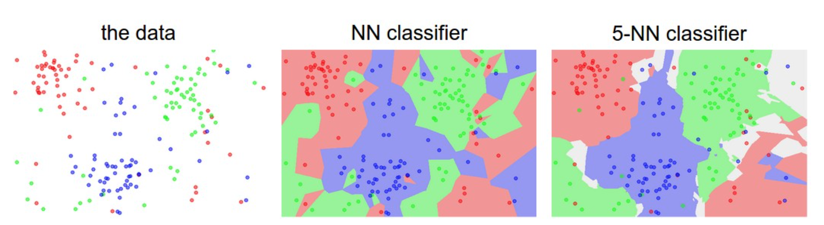
Nearest Neighbor classifier
CS231n Chapter1 : Image Classification

Slide 6
Parameter Vs Hyperparameter
CS231n Chapter1 : Image Classification
Hyperparameter
Training Data
Model
Trained Model (parameter)
K, Distance function
CIFAR-10
----------------------
Delta, Lambda
CIFAR-10
parameter
K-Nearest Neighbor Classifier
---------------------------------
Trained Linear Classifier
K-Nearest Neighbor Classifier
None
----------------------------------
Linear Classifier
Weight, Bias

Slide 7
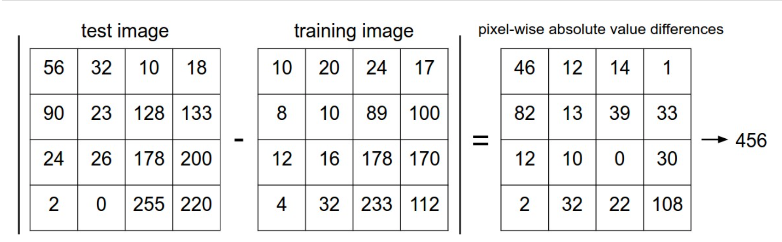
Validation set
CS231n Chapter1 : Image Classification
Training Set - (Validation Set) - Test Set
Evaluate on the test set only a single time, at the very end.

Slide 8
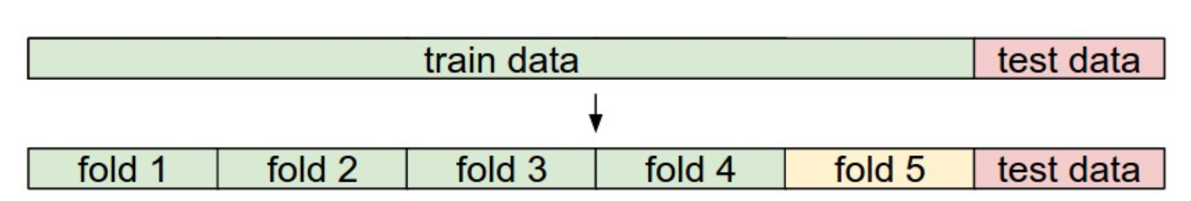
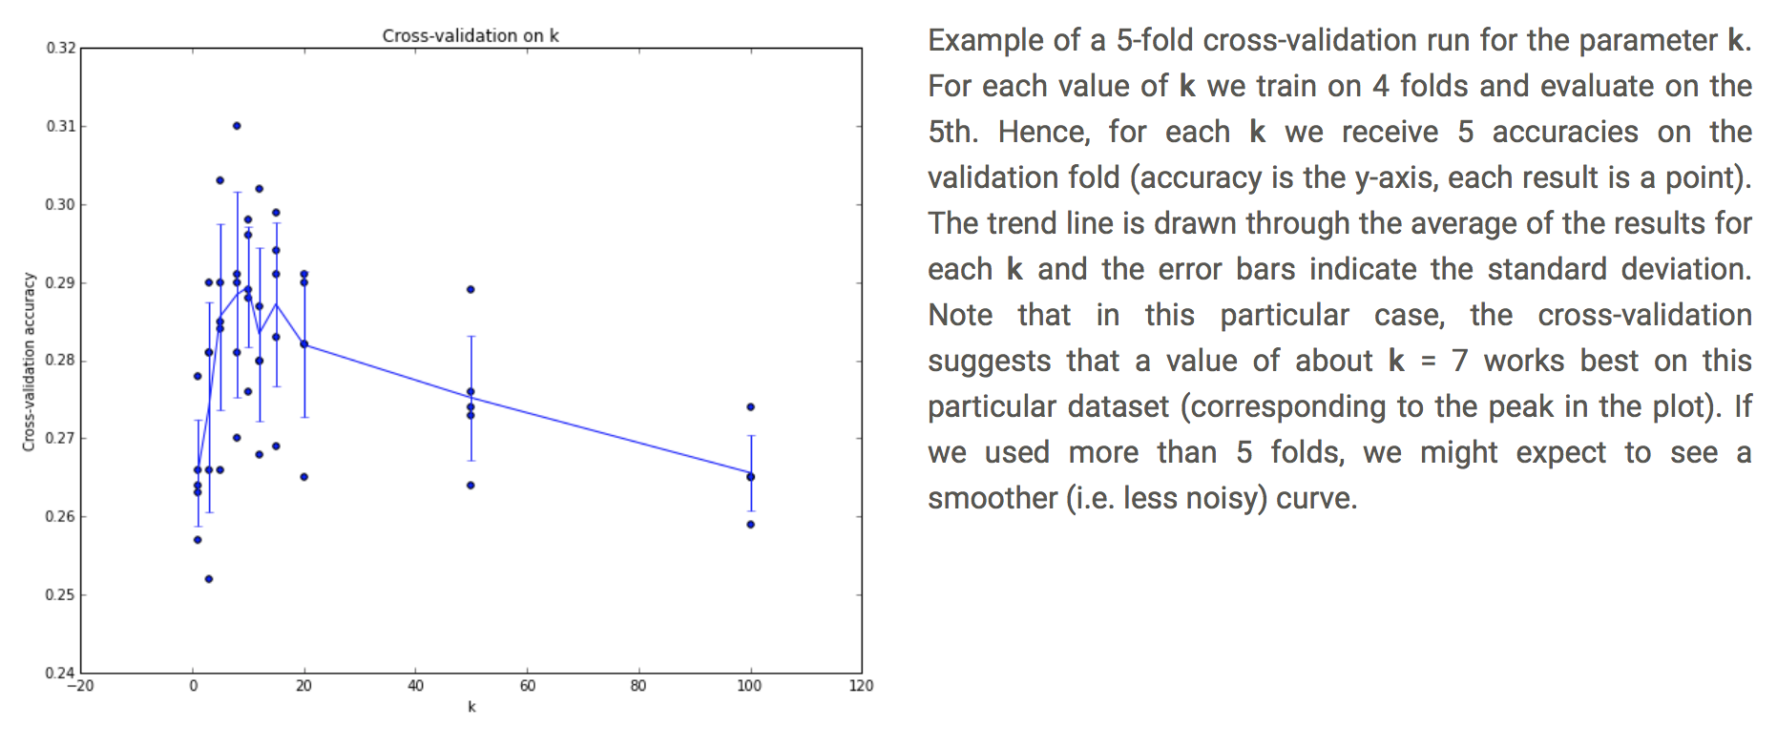
Cross-validation
CS231n Chapter1 : Image Classification

Slide 9
Jupyter Notebook
꿀팁
Tab = autocomplete
Shift+ Enter = run cell & select below
ESC = command mode
A , B = add cell
C , V = copy & paste
D+D = delete cell
Cmd + delete = delete word before

